Slide 1
LETTERING (IS: 9609 – 1990)
Lettering: Writing of Titles, Dimensions, Notes and other particulars on a drawing, is called Lettering.
Single Stroke Letters: The thickness of line of letters should be such as is obtained in one stroke of pencil.
It does not mean that the letter should be made in one stroke without lifting the pencil.
Single stroke letters are of two types:
1. Vertical
2. Inclined– 75 degrees with horizontal.
Proportions of lettering : Normal, Condensed, Extended
Classifications:
Gothic, Roman, Free hand ,mechanical

Slide 2
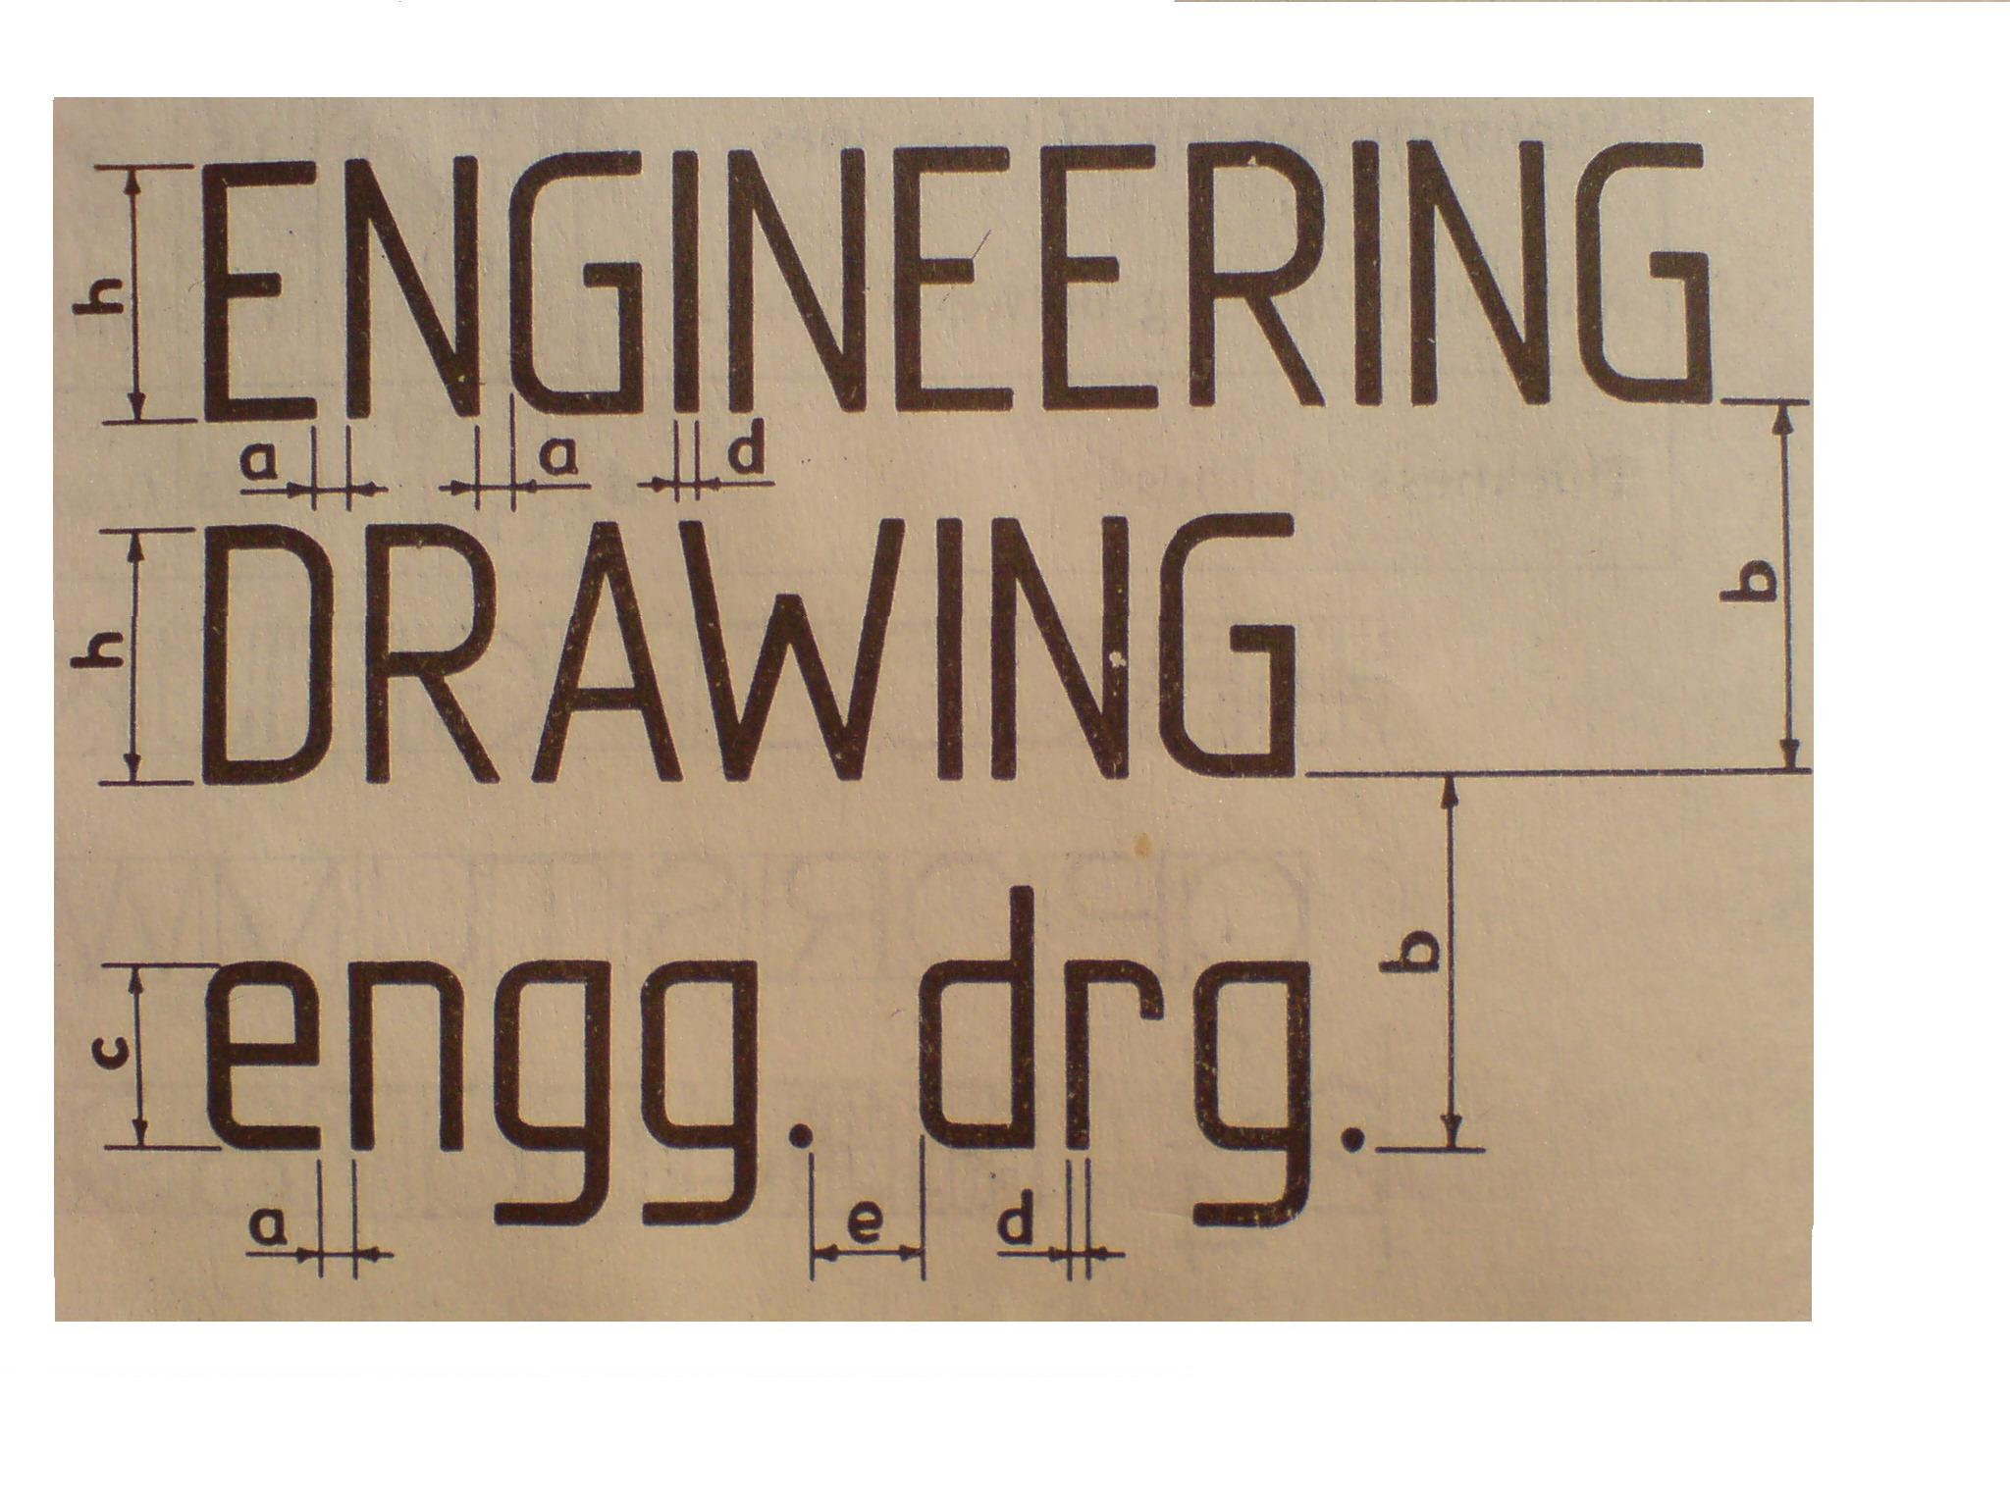

Slide 3
DIMENSIONS OF LETTERING
CHARACTERISTIC | RATIO | DIMENSIONS (mm)
Lettering Height ‘A’ (d = h/14)
Height of Capital Letters h Height of Lower Case Letters c Spacing between Characters a Minimum Spacing of Base Line b Minimum Spacing between Words e | (14/14) h (10/14) h (02/14) h (20/14) h (06/14) h | 2.5 - 0.35 3.5 1.05 | 3.5 2.5 0.5 5 1.5 | 5 3.5 0.7 7 2.1 | 7 5 1 10 3 | 10 7 1.4 14 4.2 | 14 10 2 20 6 | 20 14 2.8 28 8.4
Thickness of Lines d | (01/14) h | 0.18 | 0.25 | 0.35 | 0.5 | 0.7 | 1 | 1.4

Slide 4

RECOMMENDED HEIGHTS OF LETTERS
S.No. | PURPOSE | SIZE IN mm
1. | Main Titles, Drawing Numbers | 10
2. | Subtitles | 5
3. | Dimensions and Notes | 3

Slide 5
CONVENTION AND SYMBOL
THE REPRESENTATION OF ANY MATTER BY SOME SIGN OR MARK ON THE DRAWING IS KNOWN AS CONVENTION OR CODE OR SYMBOL.
DIFFERENT CONVENTIONS :
A few of these are given below--
1. Convention of Lines
2. Convention of Materials
3. Convention of Thread
4. Convention of Breaks
5. Convention of Surface Roughness

Slide 6
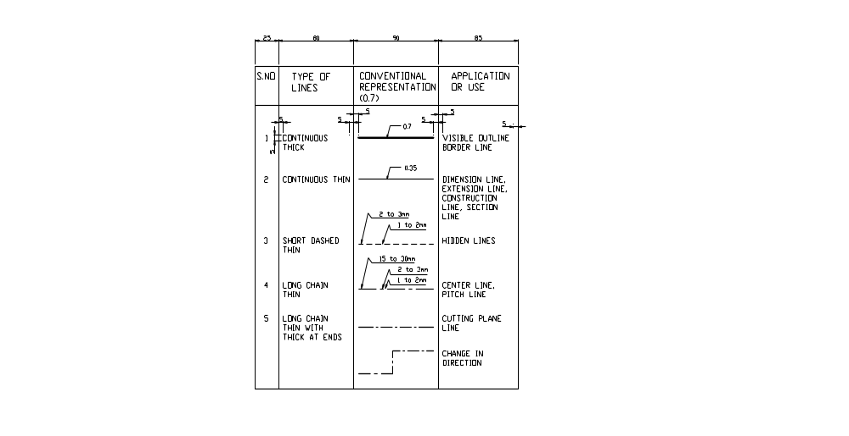
CONVENTION OF LINES

Slide 7
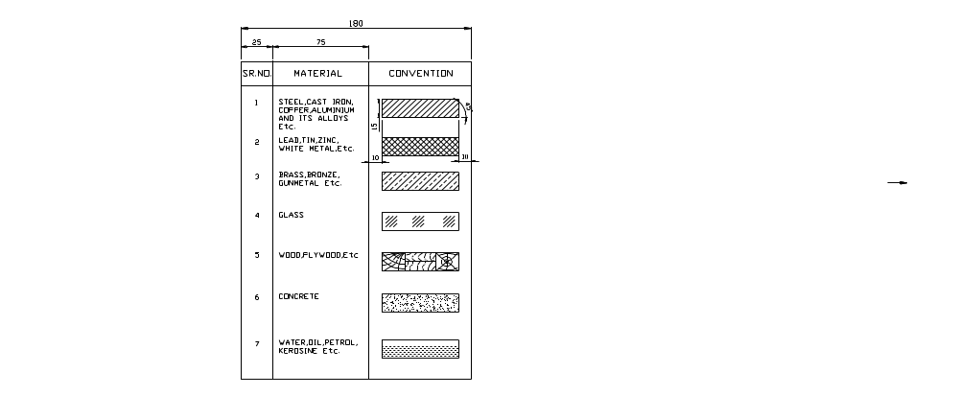
CONVENTION OF MATERIALS

Slide 8
IMPORTANCE OF DIMENSIONING
It expresses all sizes and other information necessary to define the object completely.
It must be done with due regard to manufacturing process and inspection requirements.
It includes expression of tolerances necessary for the correct functioning of the part given to be assembled.
4. Any discrepancy in shape or size can be checked.
Notes:
DIMENSIONING-

Slide 9
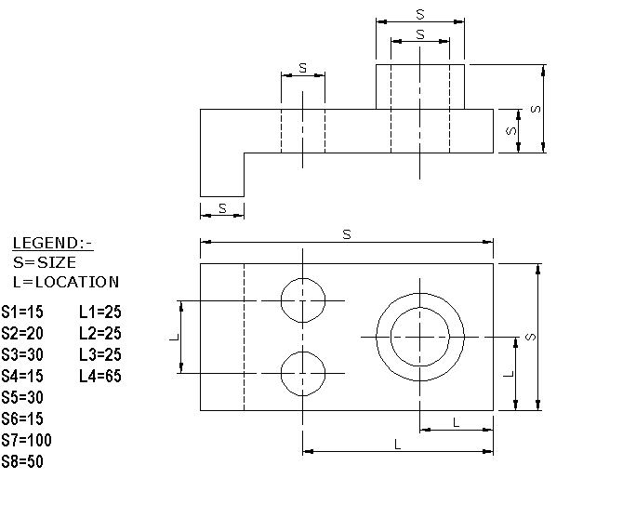
TYPES OF DIMENSIONING
Two Types :-
1. Size Dimensioning
2. Location Dimensioning

Slide 10
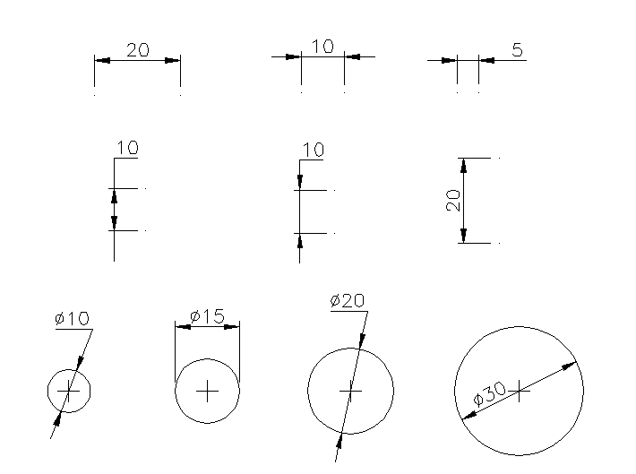
WAYS OF DIMENSIONING

Slide 11
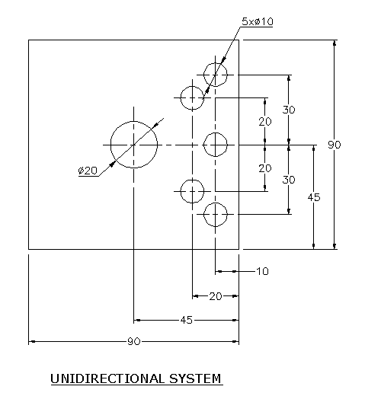
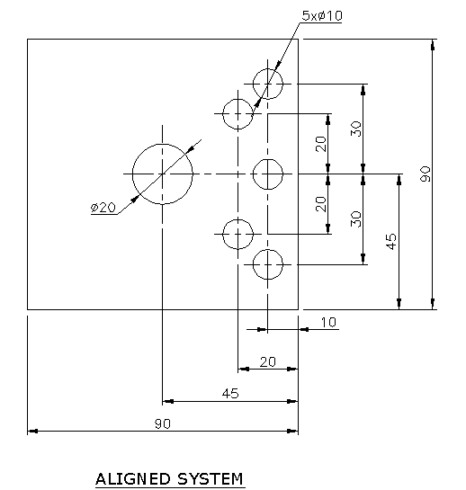
SYSTEM OF DIMENSIONING

Slide 12
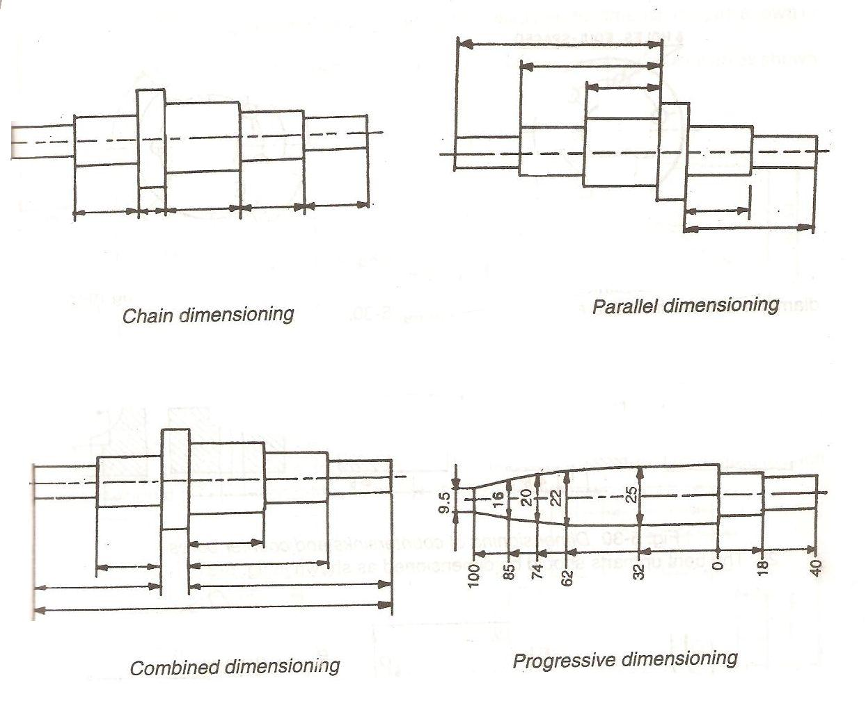
TYPES OF DIMENSIONING

Slide 13
PRINCIPLE OF DIMENSIONING
OR
GENERAL RULES OF DIMENSIONING
Dimensioning should be done so completely that further calculations or assumptions of any dimension, or direct measurement from the drawing is not necessary.
Every dimension must be given, but none should be given more than once.
A dimension should be placed on the view where its use is shown more clearly.
Dimension should be placed outside the views, unless it is clearer and more easily read inside.
Mutual cutting/crossing of dimension lines and dimensioning between hidden lines should be avoided. Dimension lines should not cross any other lines of drawing.
An outline or a centre line should never be used as a dimension line. A centre line may be extended to serve as an extension line.
Unidirectional system of dimensioning is recommended.

